Slide 1
Time Series Foundation Model Comparison
T CED INW-CN | YANG Shaopeng

Slide 2
Time Series Foundation Model Comparison
Name(stars) | TimesFM (3.4k) | TimeGPT (2.1k) | Moment (268) | Lag-Llama (1.1k) | Chronos (2.2k) | GTT
Architecture | Decoder-only | Transformer (Encoder), SaaS | Transformer (Encoder) | Probabilistic forecasting model | (Language) Models for Probabilistic forecasting | Encoder-only, SaaS
Variate No. | Uni | Multi | Multi | Uni | Uni | Multi
Support big data | No | Yes | Not mentioned | Yes | Not mentioned | Not mentioned
Anomaly detection | No | Yes | Yes | No | No | Yes
Classification | No | No | Yes | No | No | No
Zero-shot | Not mentioned | Yes | Yes | Yes | Yes | Yes
Fine-tuning | Yes | Yes | Yes | Yes | No | Future support
Installation | Pip install, Conda | pip | pip | Git clone | pip install git+https | pip
GPU support | Yes, CUDA; CPU | Not mentioned | Not mentioned | Yes, CUDA | Yes, CUDA | No
Irregular Timestamps | Not support | Support | Not mentioned | Support missing values | Not mentioned | Not mentioned
Limitation | 1. Context length:512; 2. Point forecast only; 3. Contiguous context. 4.huggingface needed | 1. Cloud service. 2. Pricing: $1000 free credit. 3. No missing value. | 1. Context length: 512. | 1. Context length: 32-256. 2. model from hugging_face. | 1. Model from hugging_face. 2. Rely on AutoGluon. 3. Not support covariates. | 1. Model on server. 2. Support long context forecast.
License | APL-2.0 | APL-2.0 | MIT | APL-2.0 | APL-2.0 | Siemens Inner Source License V1.5

Slide 3
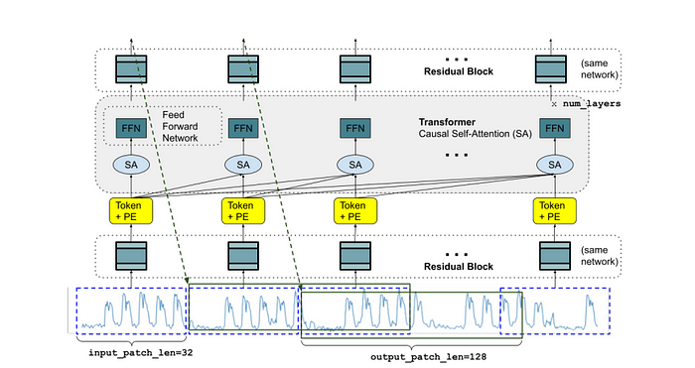
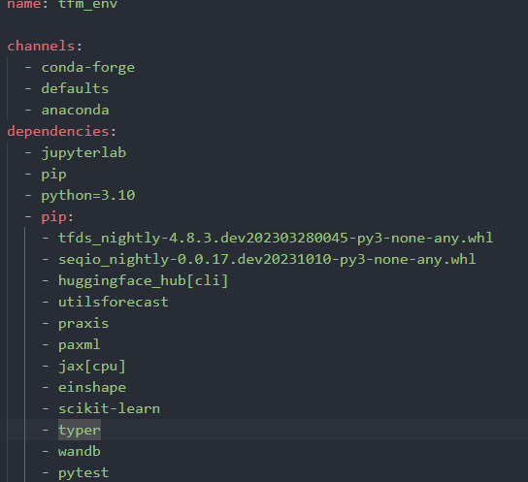
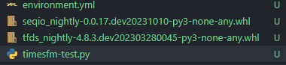
TimesFM
Installation
pip install timesfm could not work (ubuntu 20.04) due to dependencies conflicts like jax
Download seqio and tfds whls to local folder
Download and modify environment.yml from repo according to issue.
Execute conda env create --file=environment.yml to install dependencies.
Execute pip install timesfm now to install timesfm.
Architecture
Files in folder
Environment.yml

Slide 4
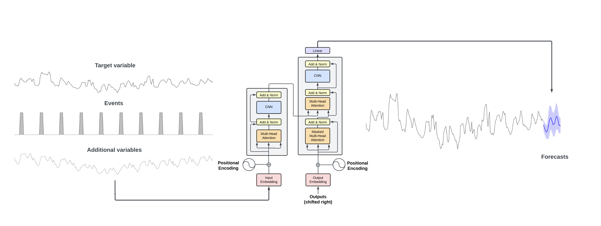
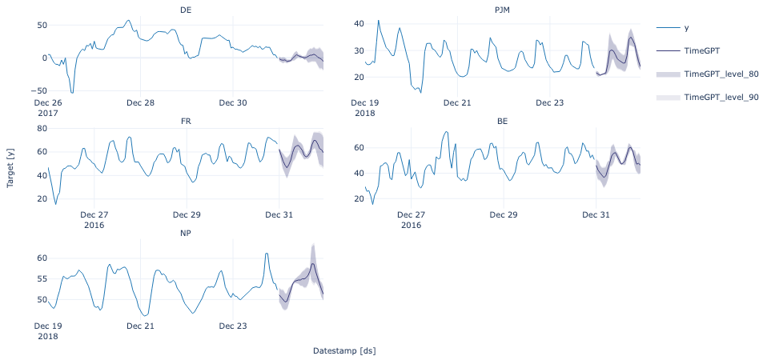
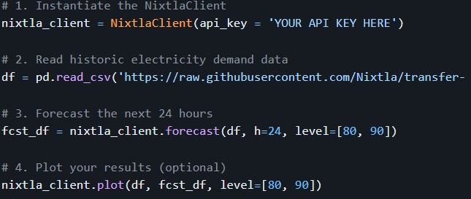
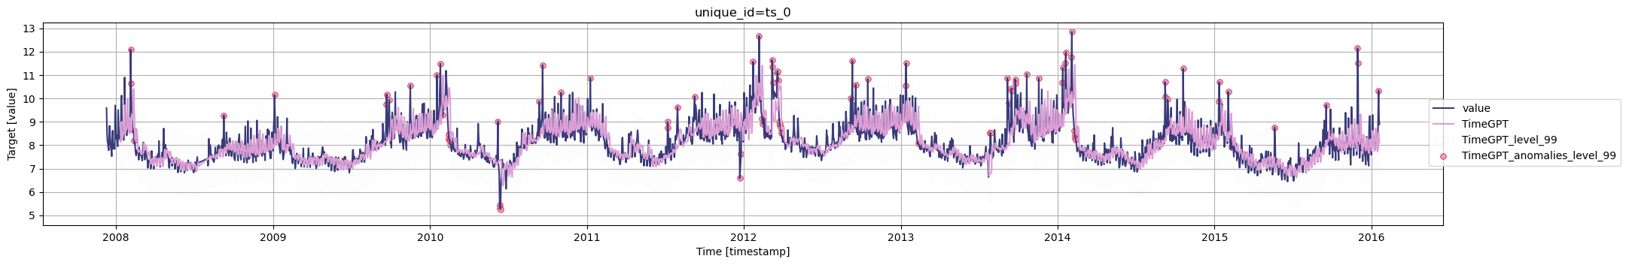
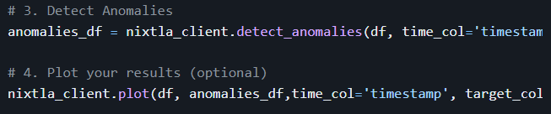
TimeGPT
Architecture
Forecast
Anomaly
detection

Slide 5
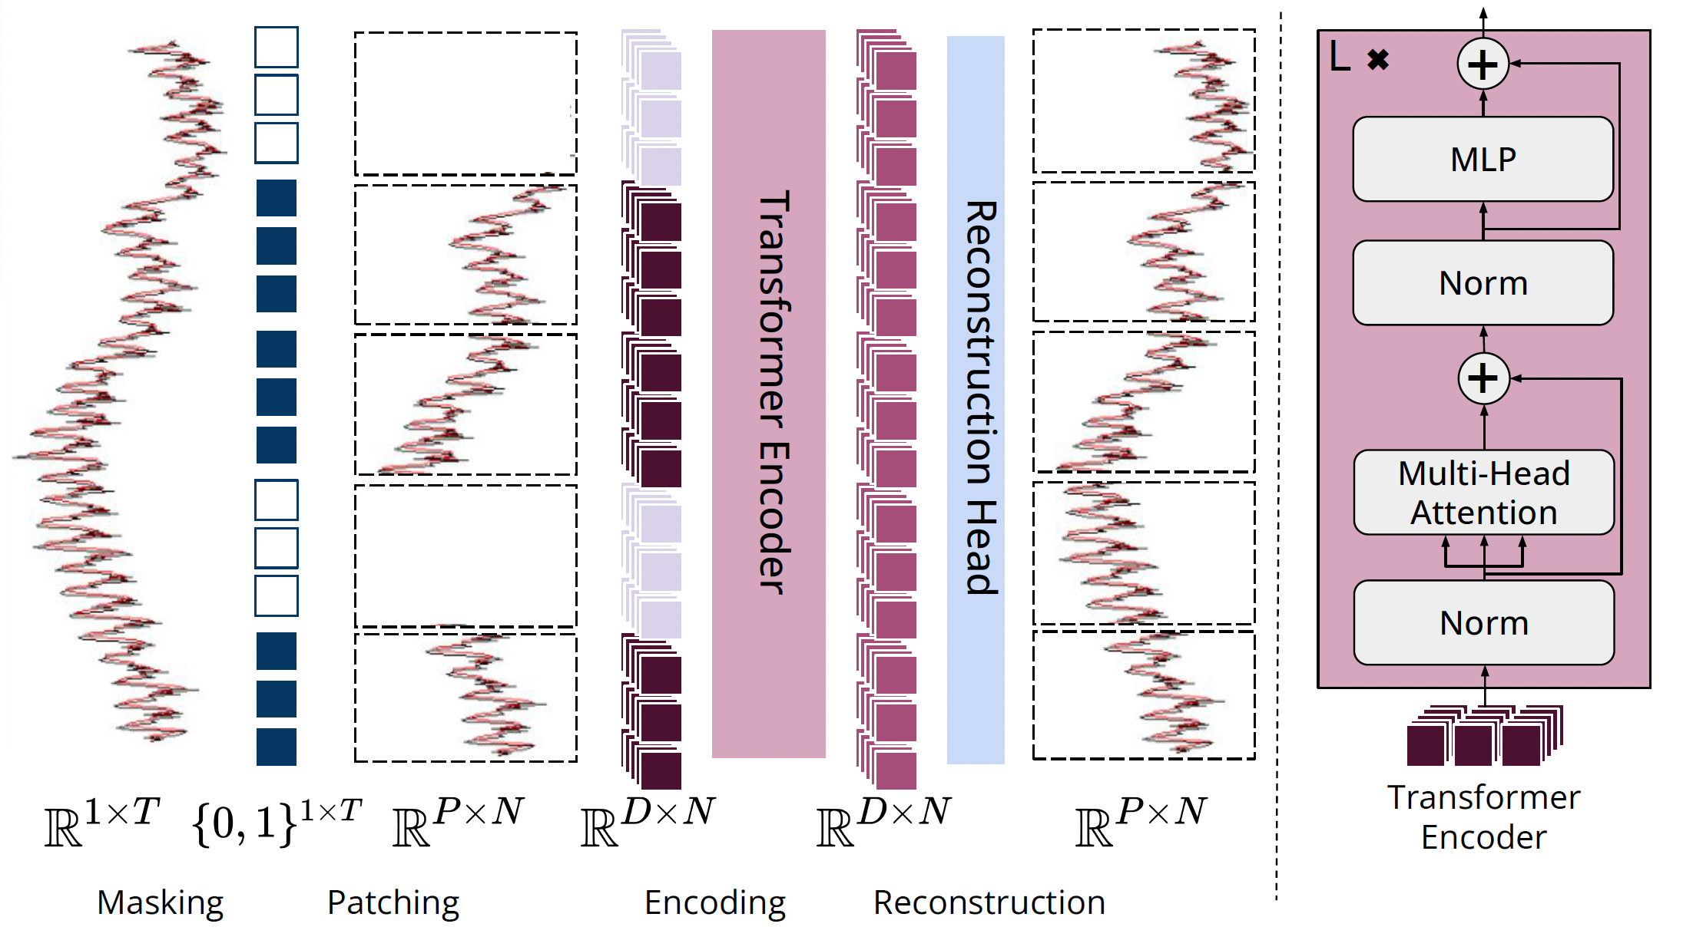
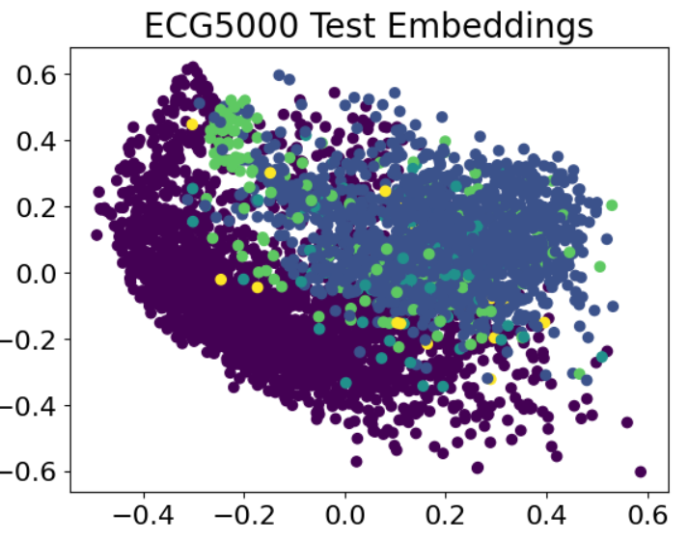
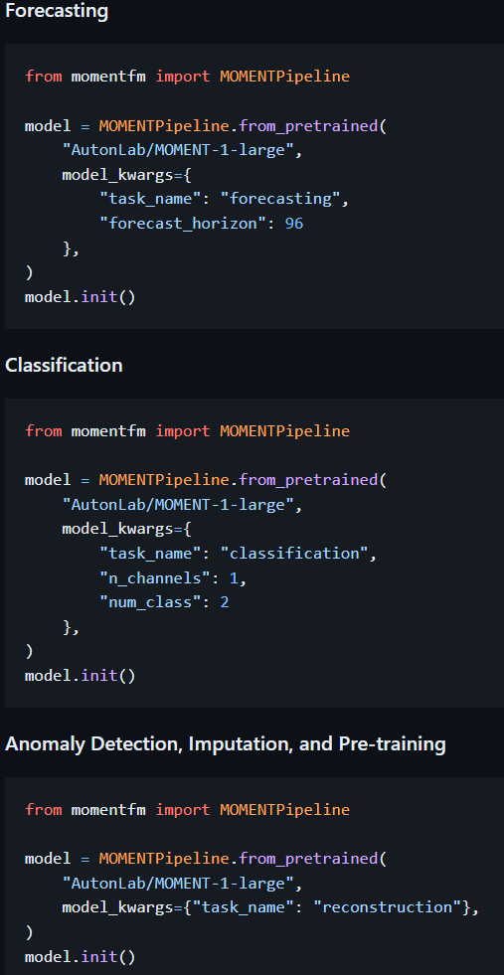
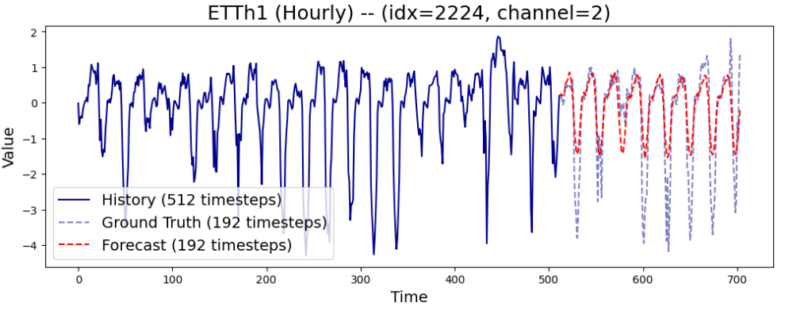
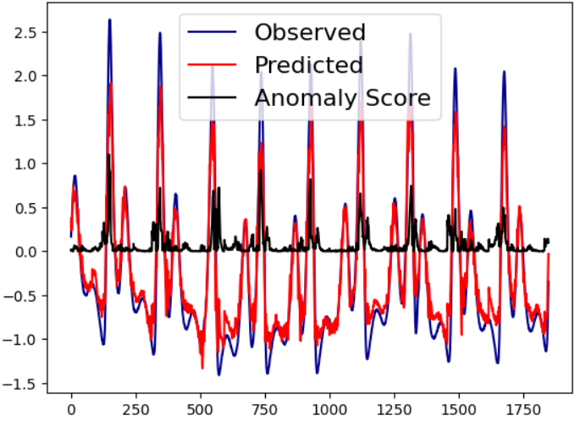
Moment
Classification
Architecture
Forecast
Anomaly detection

Slide 6
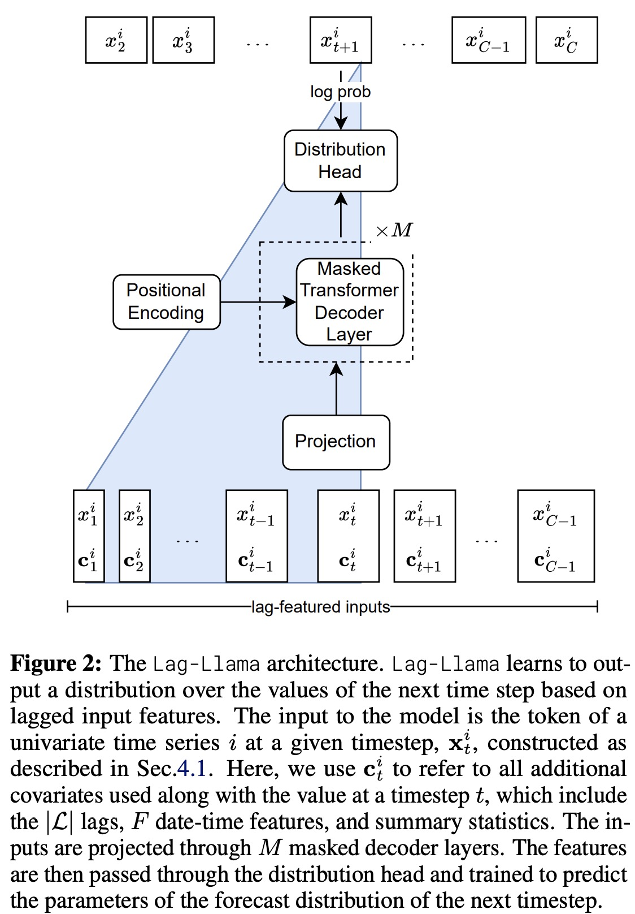
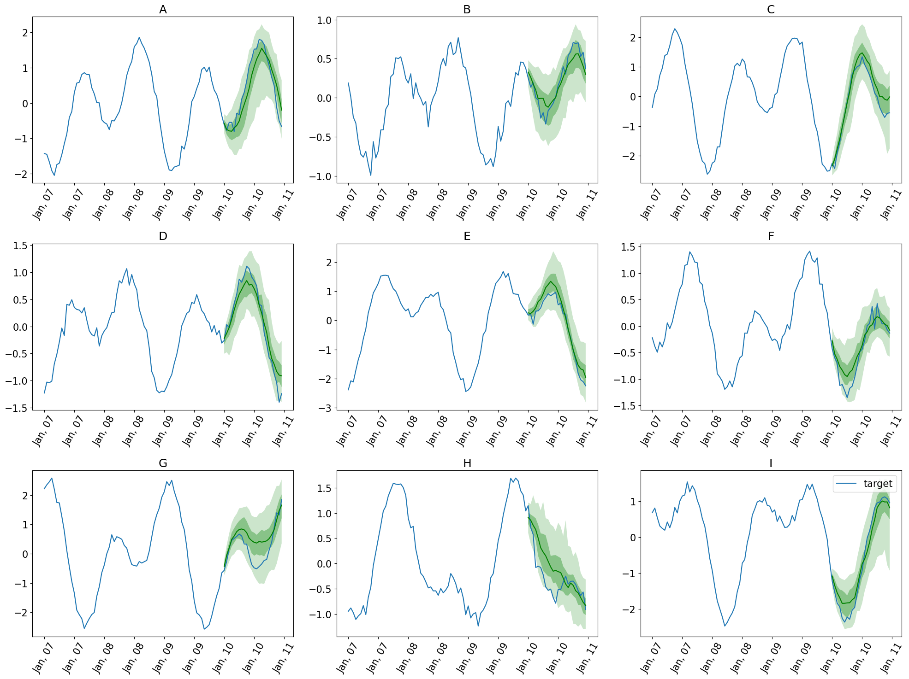
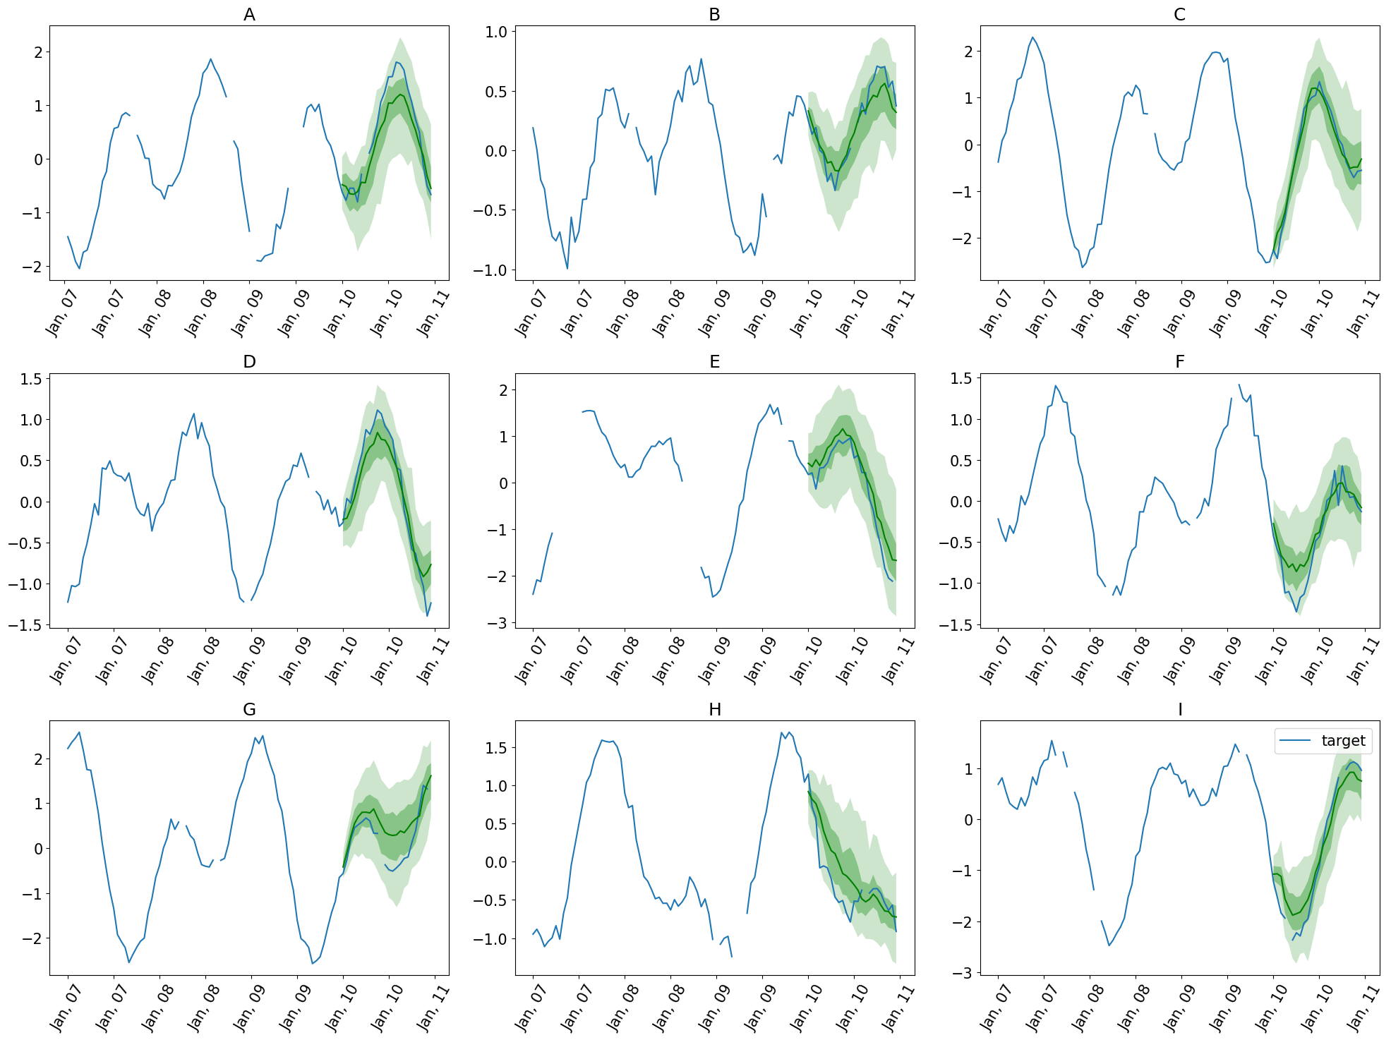
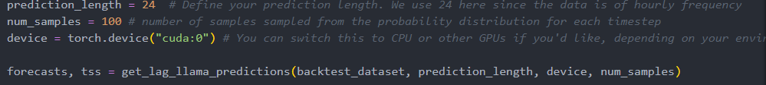
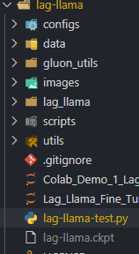
Lag-Llama
Forecast
Forecast with missing values
Lag-llama is installed using git clone, will pull the whole folder in order to use it.
Architecture

Slide 7
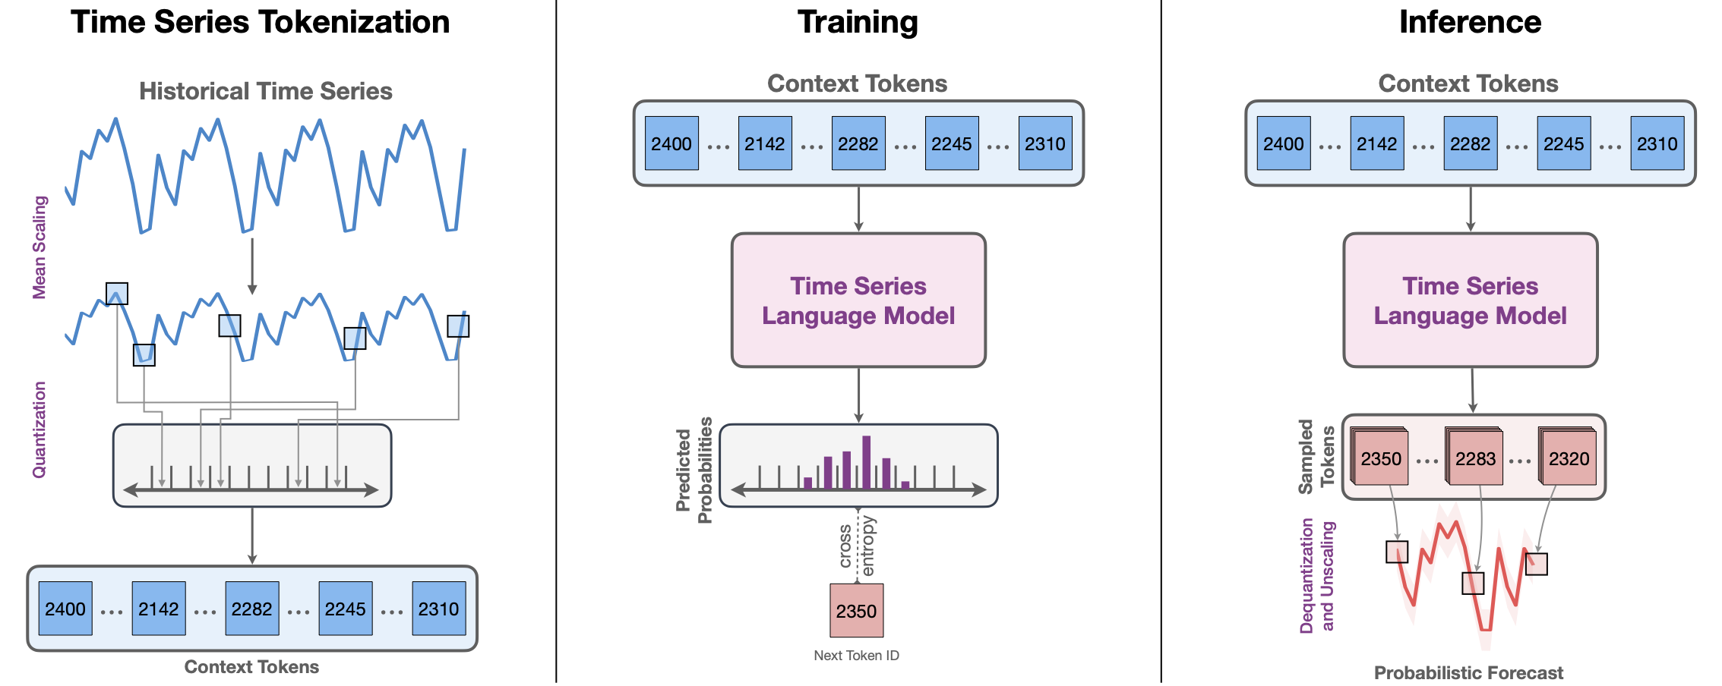
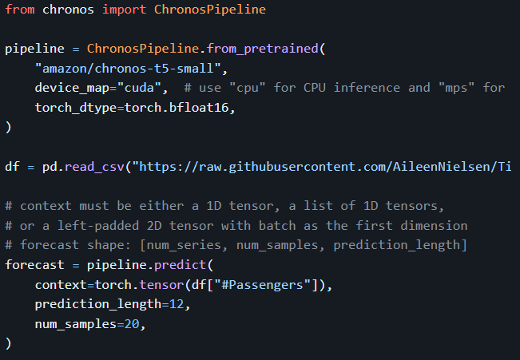
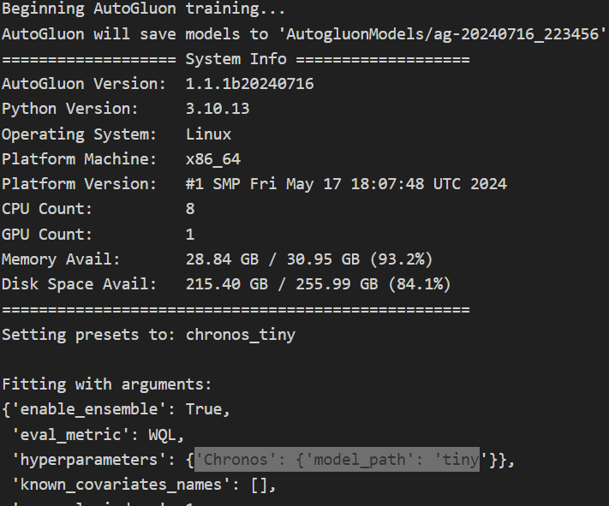
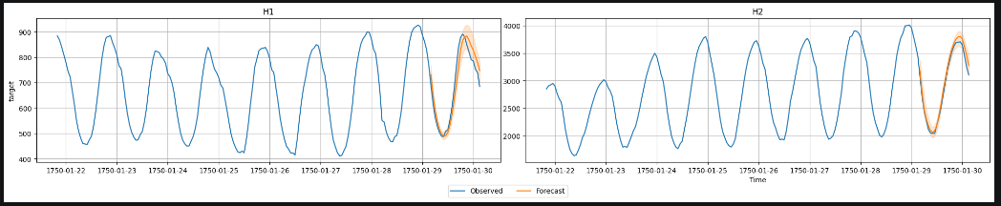
Chronos
Architecture
Forecast
Recommended: using AutoGluon

Slide 8
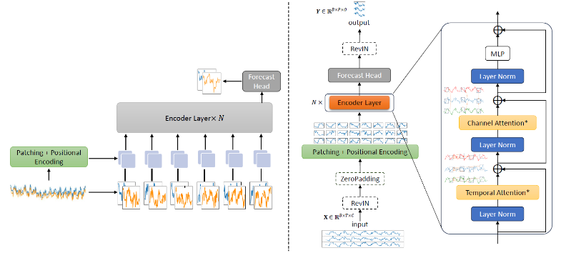
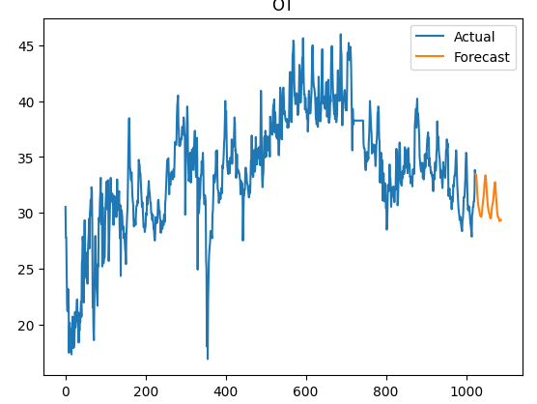
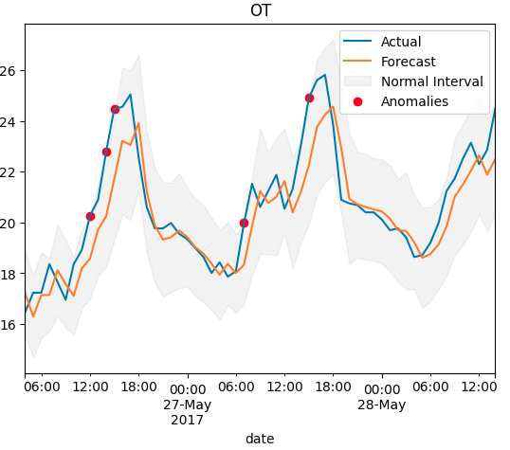
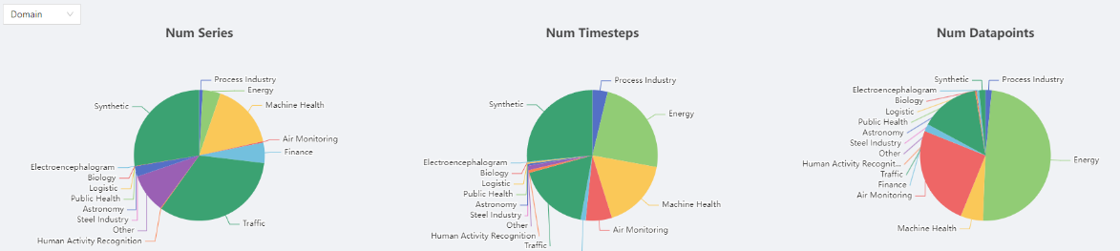
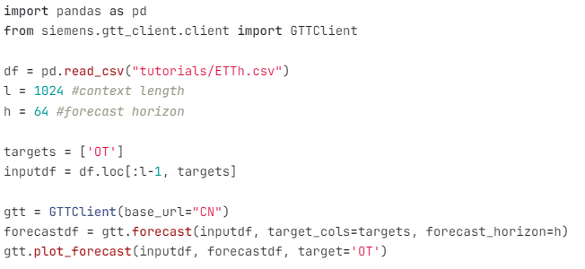
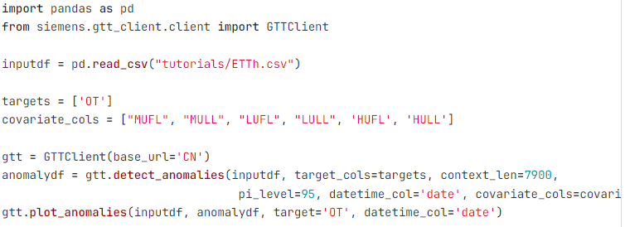
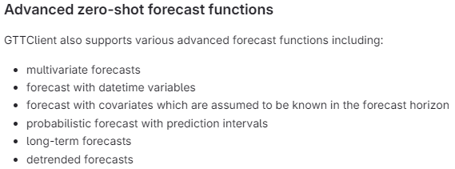
GTT
Architecture
Forecast
Anomaly detection
Dataset

Slide 9
Open Questions
Experience and knowledge sharing on choosing and using TSFMs, would be great if sharing best practices of using and deployment
Infrastructure of TSFM? For example, hugging_face access. A centralized server? GPU requirement?
Comparison with traditional machine learning forecasting libraries like Darts, Prophet, LSTM both advantages and scenarios
Dataset and evaluation

Slide 10
Backup

Slide 11
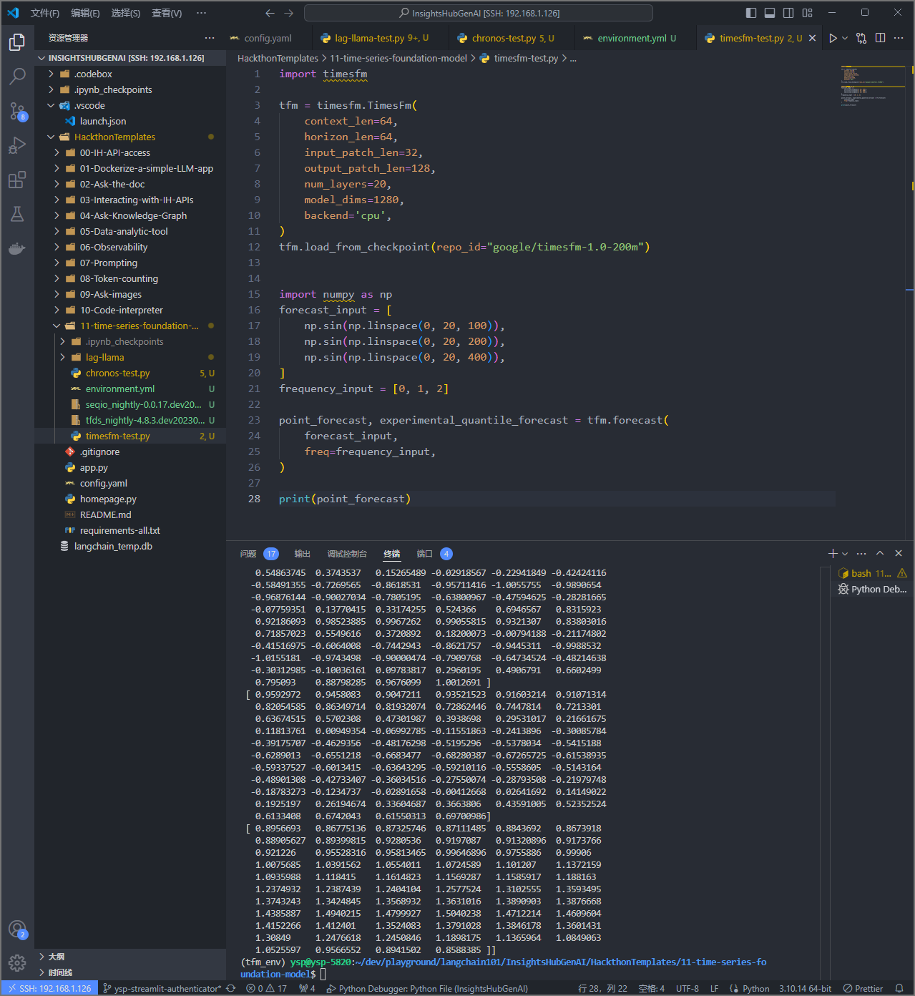
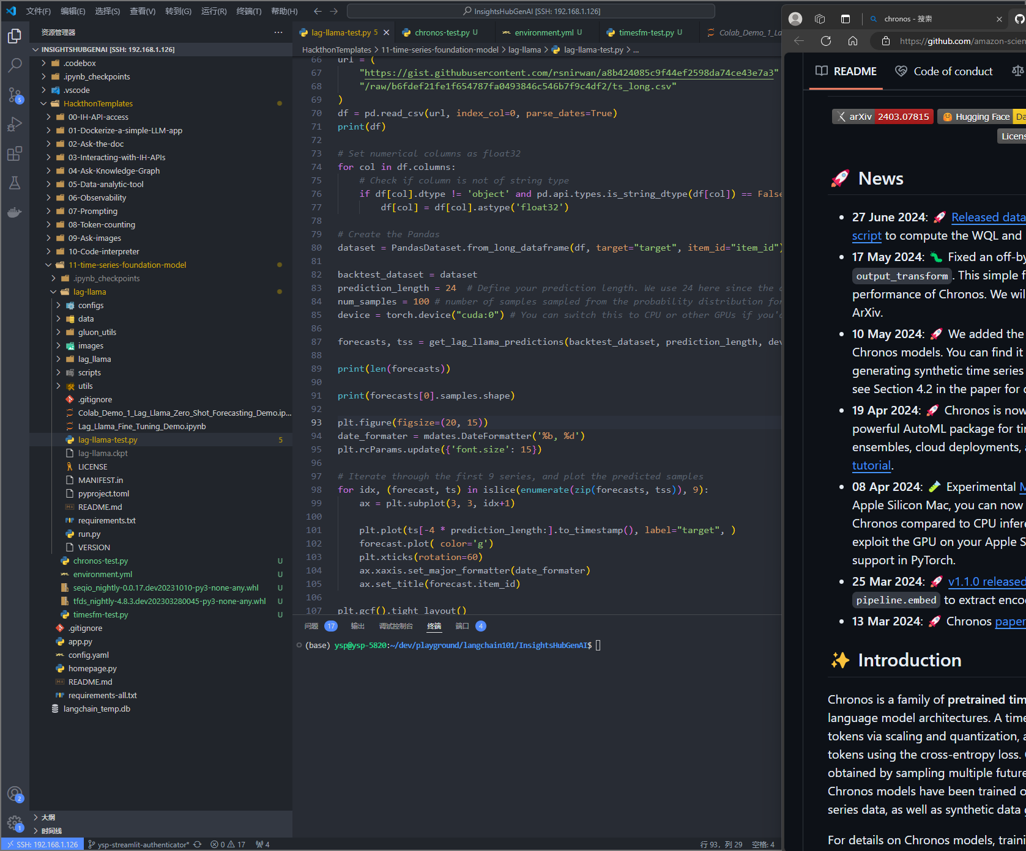

Slide 12
References
人工智能 - 谷歌的时间序列预测的基础模型TimesFM详解和对比测试 - deephub - SegmentFault 思否
TimesFM — Google’s Foundational Model for Time Series Forecasting | Towards AI
lhw828/timesfm: Google timesfm 实战部署/本地部署详细记录 (github.com)
Forecasting with Chronos - AutoGluon 1.1.1 documentation

